Slide 1
Chapter 3 Inter-process Communication
Reference slides from Distributed systems concepts and design
Distributed computing Liu , and operating system concepts Silberschatz

Slide 2
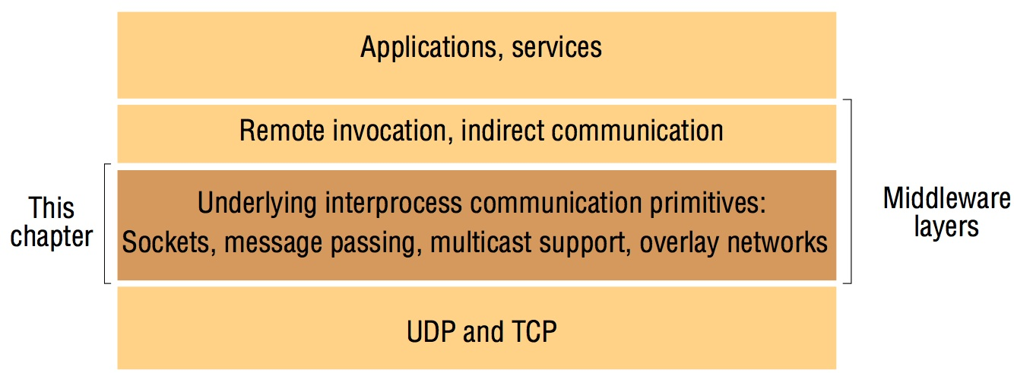
Middleware layer
This chapter is concerned with the characteristics of protocols for communication between processes. E.g. Java API
RMI and RPC is concerned with integrating communication into a programming language paradigm. Under RMI and RPC, there are sockets, message passing, multicast support.
Protocols for the representation of collections of data objects in messages are also discussed.

Slide 3
Synchronous and Asynchronous
Synchronous and Asynchronous communication: Sending and receiving processes may be either one of them.
Synchronous: two processes synchronize at every message. Both send and receive are blocking operations. Whenever a send issued the sending process is blocked until the receive is issued. Whenever a receive is issued by a process, it blocks until a message arrives.
Asynchronous: The send operation is non-blocking and the sending process is allowed to proceed as soon as the message has been copied to a local buffer. The receive can be either blocking or non-blocking(process can proceed and notified by polling or interrupt when background buffer filled. But no advantage due to multi-thread and overhead of implementing the mechanism).

Slide 4
Sockets and ports
any port
agreed port
socket
socket
message
client
server
other ports
Internet address = 138.37.94.248
Internet address = 138.37.88.249
Both UDP and TCP use the socket as endpoints for communication between processes. A socket is associated with a Internet address and port number. Each computer has a large number 2^16 of possible port numbers. Processes may use the same socket for sending and receiving messages.

Slide 5
TCP
TCP stream of bytes communication
A dedicated point-to-point channel
Use TCP (Transmission Control Protocol) for data transmission.
  For integrity, checksum is used to detect and reject corrupt packets an sequence numbers to detect and reject duplicate packets. For validity, timeouts and retransmission to deal with lost packets.
  So messages are guaranteed to be delivered. Lossless and reliable. Sent and received in the same order.
  Use of TCP: many frequently used services run over TCP connections
  HTTP, FTP, Telnet, SMTP

Slide 6
UDP
UDP datagram communication: attractive due to no overheads associated with guaranteed message delivery
No dedicated point-to-point channel
Use UDP (User Datagram Protocol) for data transmission. No acknowledge and retries.
  Omission failure as messages may be dropped occasionally either because of checksum error or no buffer space at source or destination
  Messages can be sometimes be delivered out of sender order
  So applications using UDP are left to provide their own checks to achieve quality of reliable communication that suffers from omission failures, which can be constructed by using acknowledgements.
  Applications that are acceptable to have occasional omission failure and out of order. For example, DNS and Voice Over IP (VOIP)

Slide 7
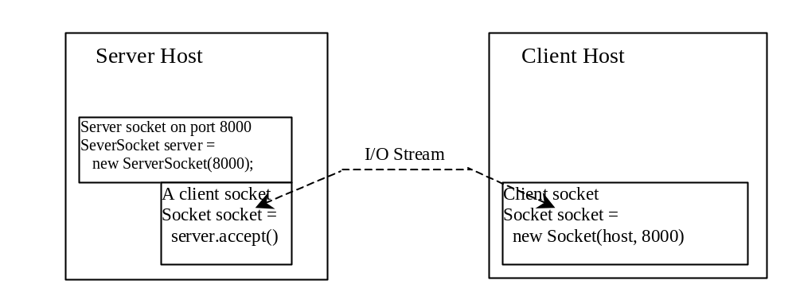
Client/Server Communications: TCP
The server must be running when a client starts. The server waits for a connection request from a client. To establish a server, you need to create a server socket and attach it to a port, which is where the server listens for connections.
After the server accepts the connection, communication between server and client is conducted the same as for I/O streams.
After a server socket is created, the server can use this statement to listen for connections.
The client issues this statement to request a connection to a server.

Slide 8
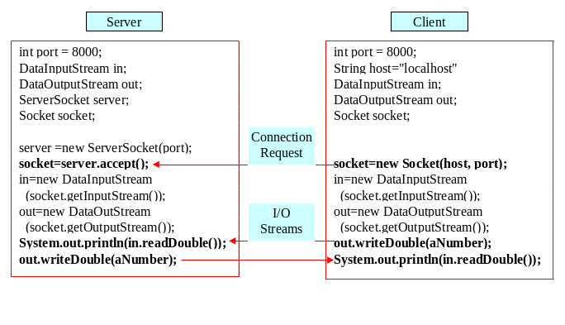
Data Transmission through Sockets
InputStream input = socket.getInputStream();
OutputStream output = socket.getOutputStream();

Slide 9
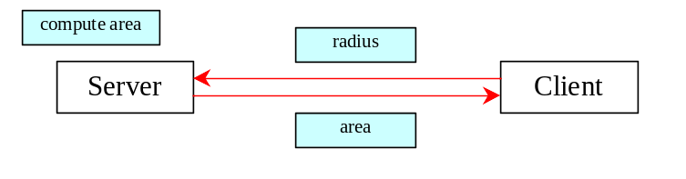
A TCP Client/Server Example
Problem: Write a client to send data to a server. The server receives the data, uses it to produce a result, and then sends the result back to the client. The client displays the result on the console. In this example, the data sent from the client is the radius of a circle, and the result produced by
the server is the area of the circle.

Slide 10
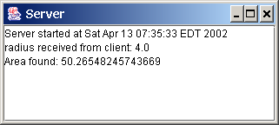
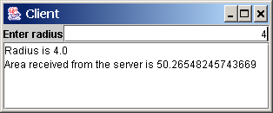
A Client/Server Example, cont.
Server Code
Client Code
Start Server
Start Client
Note: Start the server, then the client.

Slide 11
The InetAddress Class
Occasionally, you would like to know who is connecting to the server. You can use the InetAddress class to find the client's host name and IP address. The InetAddress class models an IP address. You can use the statement shown below to create an instance of InetAddress for the client on a socket.
  InetAddress inetAddress = socket.getInetAddress();
Next, you can display the client's host name and IP address, as follows:
  System.out.println("Client's host name is " +
  inetAddress.getHostName());
  System.out.println("Client's IP Address is " +
  inetAddress.getHostAddress());

Slide 12
Serving Multiple Clients
Multiple clients are quite often connected to a single server at the same time. Typically, a server runs constantly on a server computer, and clients from all over the Internet may want to connect to it. You can use threads to handle the server's multiple clients simultaneously. Simply create a thread for each connection. Here is how the server handles the establishment of a connection:
    while (true) {
    Socket socket = serverSocket.accept();
    Thread thread = new Thread(new ThreadClass(socket));
    thread.start();
    }
The server socket can have many connections. Each iteration of the while loop creates a new connection. Whenever a connection is established, a new thread is created to handle communication between the server and the new client; and this allows multiple connections to run at the same time.

Slide 13
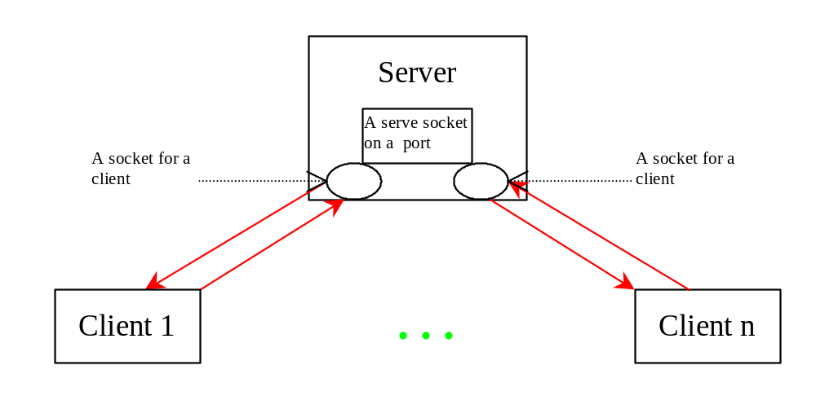
Example: Serving Multiple Clients
Server for Multiple Clients
Start Server
Start Client
Note: Start the server first, then start multiple clients.

Slide 14
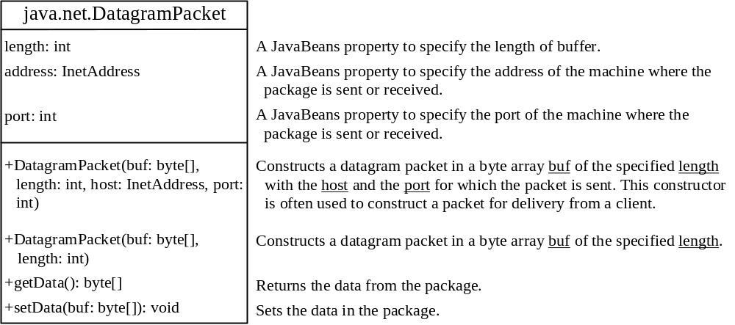
DatagramPacket
The DatagramPacket class represents a datagram packet. Datagram packets are used to implement a connectionless packet delivery service. Each message is routed from one machine to another based solely on information contained within the packet.

Slide 15
DatagramSocket
DatagramSocket
Create a server DatagramSocket
Create a client DatagramSocket
The DatagramSocket class represents a socket for sending and receiving datagram packets. A datagram socket is the sending or receiving point for a packet delivery service. Each packet sent or received on a datagram socket is individually addressed and routed. Multiple packets sent from one machine to another may be routed differently, and may arrive in any order.
To create a server DatagramSocket, use the constructor DatagramSocket(int port), which binds the socket with the specified port on the local host machine.
To create a client DatagramSocket, use the constructor DatagramSocket(), which binds the socket with any available port on the local host machine.

Slide 16
Sending and Receiving a DatagramSocket
Sending
Receiving
To send data, you need to create a packet, fill in the contents, specify the Internet address and port number for the receiver, and invoke the send(packet) method on a DatagramSocket.
To receive data, create an empty packet and invoke the receive(packet) method on a DatagramSocket.

Slide 17
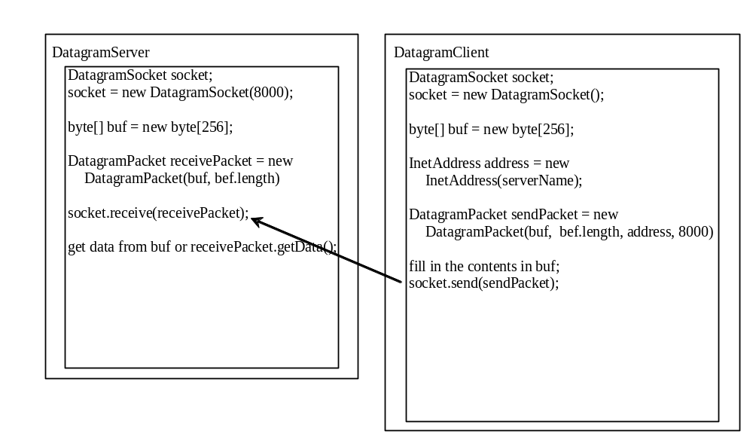
Datagram Programming
Datagram programming is different from stream socket programming in the sense that there is no concept of a ServerSocket for datagrams. Both client and server use DatagramSocket to send and receive packets.
Designate on a server

Slide 18
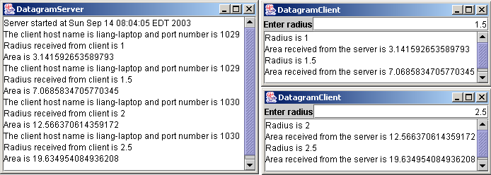
Example: A Client/Server Example
Already present a client program and a server program using socket streams. The client sends radius to a server. The server receives the data, uses them to find the area, and then sends the area to the client. Rewrite the program using datagram sockets.
Server Code
Client Code
Note: Start the server, then the client.
Start Server
Start Client

Slide 19
Client/Server Communications
Both forms of communication UDP and TCP use the socket abstraction, which provides endpoint for communication between processes.
Each socket is associated with a particular protocol either UDP or TCP.
Each Internet host has 2^16 (65,535) logical ports. Each port is identified by a number between 1 and 65535, and can be allocated to a particular process.
Port numbers between 1 and 1023 are reserved for processes which provide well-known services such as finger, FTP, HTTP, and email.

Slide 20
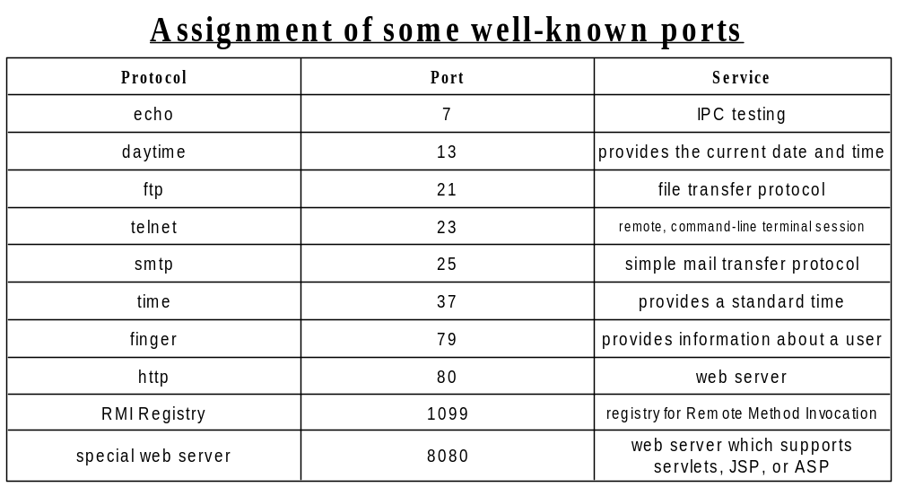
Ports Assignment

Slide 21
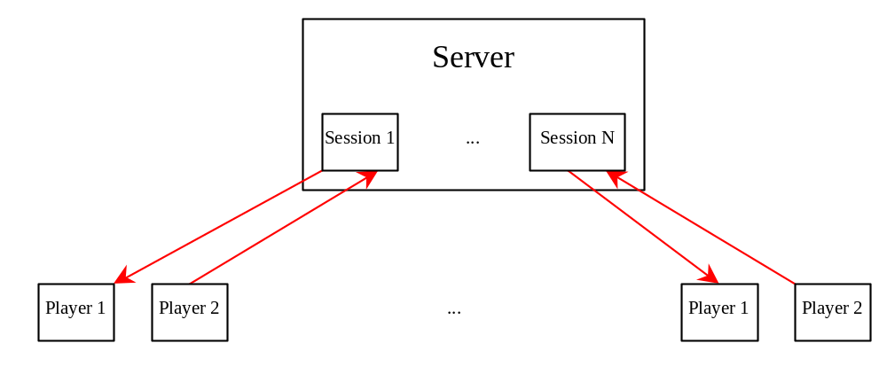
Case Studies: Distributed TicTacToe Games
TicTacToeServer
Run Server
TicTacToeClient
Run Client

Slide 22
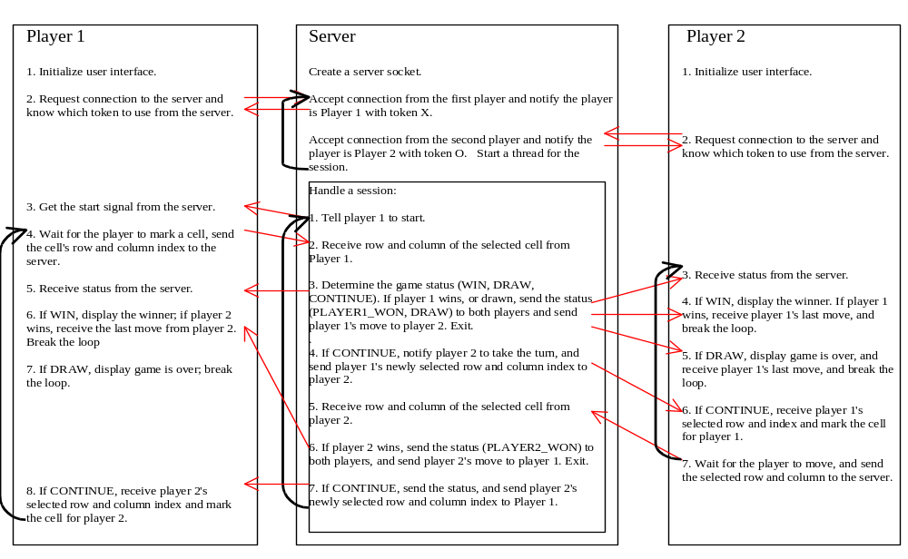
Distributed TicTacToe Game

Slide 23
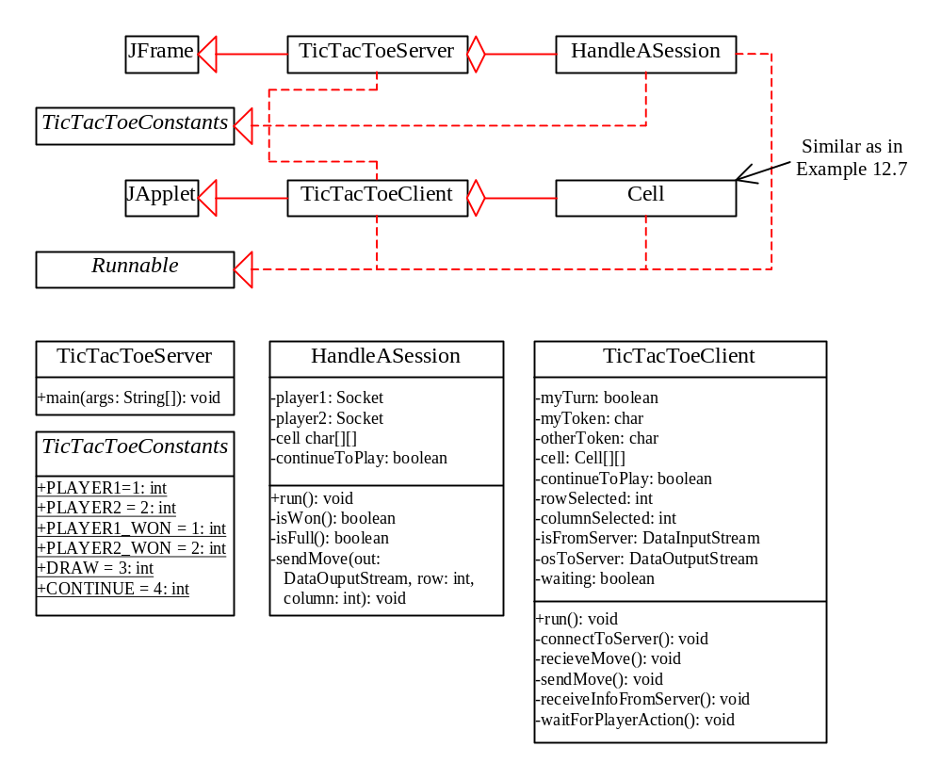
Distributed TicTacToe, cont.

Slide 24
Synchronization Revisit
Message passing may be either blocking or non-blocking
Blocking is considered synchronous
  Blocking send has the sender block until the corresponding receive is issued
  Blocking receive has the receiver block until a message arrives
Non-blocking is considered asynchronous
  Non-blocking sender proceeds after send operation (message is copied to local buffer). So the message transmission can run parallel with the sender program
  Non-blocking receiving process proceeds after receive operation, which provides a buffer to be filled in the background. But it must separately receive notification that its buffer has been filled by polling or interrupt
  In multiple thread process, blocking receive has no disadvantage. Simple synchronization and less complexity. So today system do not generally provide non-blocking receive.

Slide 25
Buffering
Queue of messages attached to the link; implemented in one of three ways
  1. Zero capacity – 0 messages
  Sender must wait for receiver (rendezvous)
  2. Bounded capacity – finite length of n messages
  Sender must wait if link full
  3. Unbounded capacity – infinite length
  Sender never waits

Slide 26
Remote Procedure Calls
Remote procedure call (RPC) abstracts procedure calls between processes on networked systems.
Stubs – client-side proxy for the actual procedure on the server.
The client-side stub locates the server and marshalls the parameters.
The server-side stub receives this message, unpacks the marshalled parameters, and performs the procedure on the server.

Slide 27
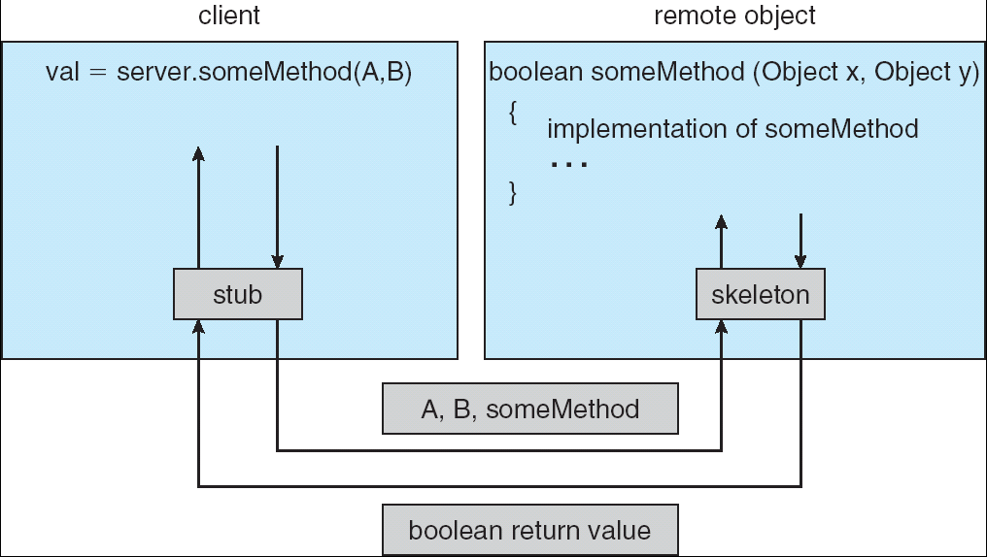
Marshalling Parameters

Slide 28

Remote Method Invocation
Remote Method Invocation (RMI) is a Java mechanism similar to RPCs.
RMI allows a Java object on one machine to invoke a method on a remote object.

Slide 29
External Data Representation and marshalling
Data transmitted on the network is a binary stream.
Because different computers may have different internal storage format for the same data type, an external representation of data may be necessary.
Data marshalling is the process of translating/ converting the data to an external representation.
Data unmarshalling is the process of rebuilding of data structure.
Three approaches to external data representation schemes are:
a. CORBA’s common data representation: can represent all data types for argument and return values for RMI in CORBA for a variety of programming languages.
b. Java’s object serialization: flatterning of an object into a serial form that can be transmitted in a message and stored on disk. It is for use only by Java. Types information is included.
c. XML (Extensible Markup Language): define a self-describing textual format for structured data for web use.

Slide 30
Example: Person Object
Struct Person {
  String name;
  String place;
  Unsigned long year;
  };

Slide 31
CORBA Common Data Representation (CDR) message
index in
notes
sequence of bytes
4 bytes
on representation
0–3
5
length of string
4–7
"Smit"
‘Smith’
8–11
"h___"
12–15
6
length of string
16–19
"Lond"
‘London’
20-23
"on__"
24–27
1934
unsigned long
The flattened form represents a
Person
struct with value: {‘Smith’, ‘London’, 1934}

Slide 32
Java serialized form
public class Person implements Serializable {
private String name;
private String place;
private int year;
public Person() {
}
}
Serialized values
Explanation
Person
8-byte version number
h0
class name, version number
int year
java.lang.String
java.lang.String
number, type and name of
3
name:
place:
instance variables
1934
5 Smith
6 London
h1
values of instance variables
The true serialized form contains additional type markers; h0 and h1 are handles

Slide 33
XML definition of the Person structure
<person id="123456789">
<name>Smith</name>
<place>London</place>
<year>1934</year>
<!-- a comment -->
</person >
Elements: portion of character data surrounded by start and end tag. Hierarchical structure is possible with element enclosing.
Attributes: start tag may include associated attribute names and values. E.g. id=“123456789”

Slide 34
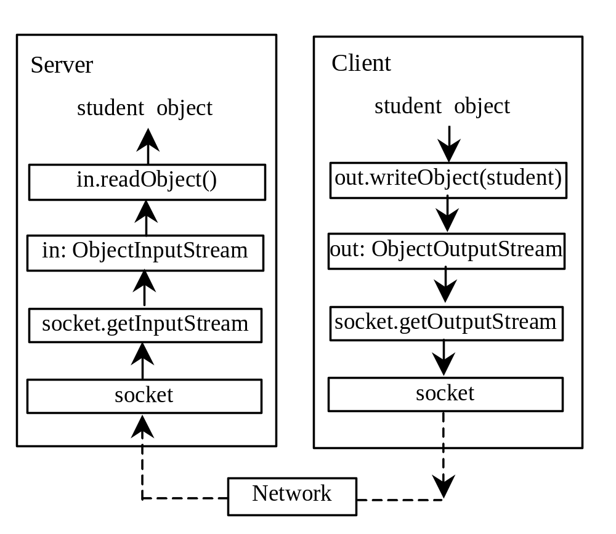
Example: Passing Objects in Network Programs
Write a program that collects student information from a client and send them to a server. Passing student information in an object.
Student Class
Student Sever
Student Client
Start Server
Start Client
Note: Start the server first, then the client.

Slide 35
Secure Sockets
Secure sockets perform encryption on the data transmitted.
The JavaTM Secure Socket Extension (JSSE) is a Java package that enables secure Internet communications.
It implements a Java version of SSL (Secure Sockets Layer) and TLS (Transport Layer Security) protocols
It includes functionalities for data encryption, server authentication, message integrity, and optional client authentication.
Using JSSE, developers can provide for the secure passage of data between a client and a server running any application protocol.

Slide 36
Secure Sockets
Import javax.net.ssl;
Class SSLServerSocket is a subclass of ServerSocket, and inherits all its methods.
Class SSLSocket is a subclass of Socket, and inherits all its methods.
Example code available:
  http://java.sun.com/javase/6/docs/technotes/guides/security/jsse/JSSERefGuide.html#UnsecureSecure

